Slide 1
ECE 100 Competition 0
Group 3
Mathew, Rezwan and Alan
LEGO HANDY BOARD HYBRID ROBOT

Slide 2
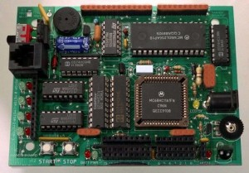
Introduction
The HandyBoard is a handheld robotics controller which was developed at MIT by Fred G. Martin
The HandyBoard contains-
68HC11 8-bit microcontroller @ 2 MHz made by Motorola
32KB battery-backed SRAM
2x16 LCD character display
Support for four 1A motors
6 Servo motor controllers
7 Digital and 9 Analog inputs
8 Digital and 16 Analog outputs
Infrared I/O capabilities
Serial interface capabilities
Sound output
HandyBoard is used as the base for building the robot
Using the HandyBoard and legos we must create a robot that can navigate a maze

Slide 3
Problem Statement
A robot needs to be created
The robot needs to navigate a maze
Create code to navigate through the maze
Add intelligence to the robot
Make it fast and efficient

Slide 4
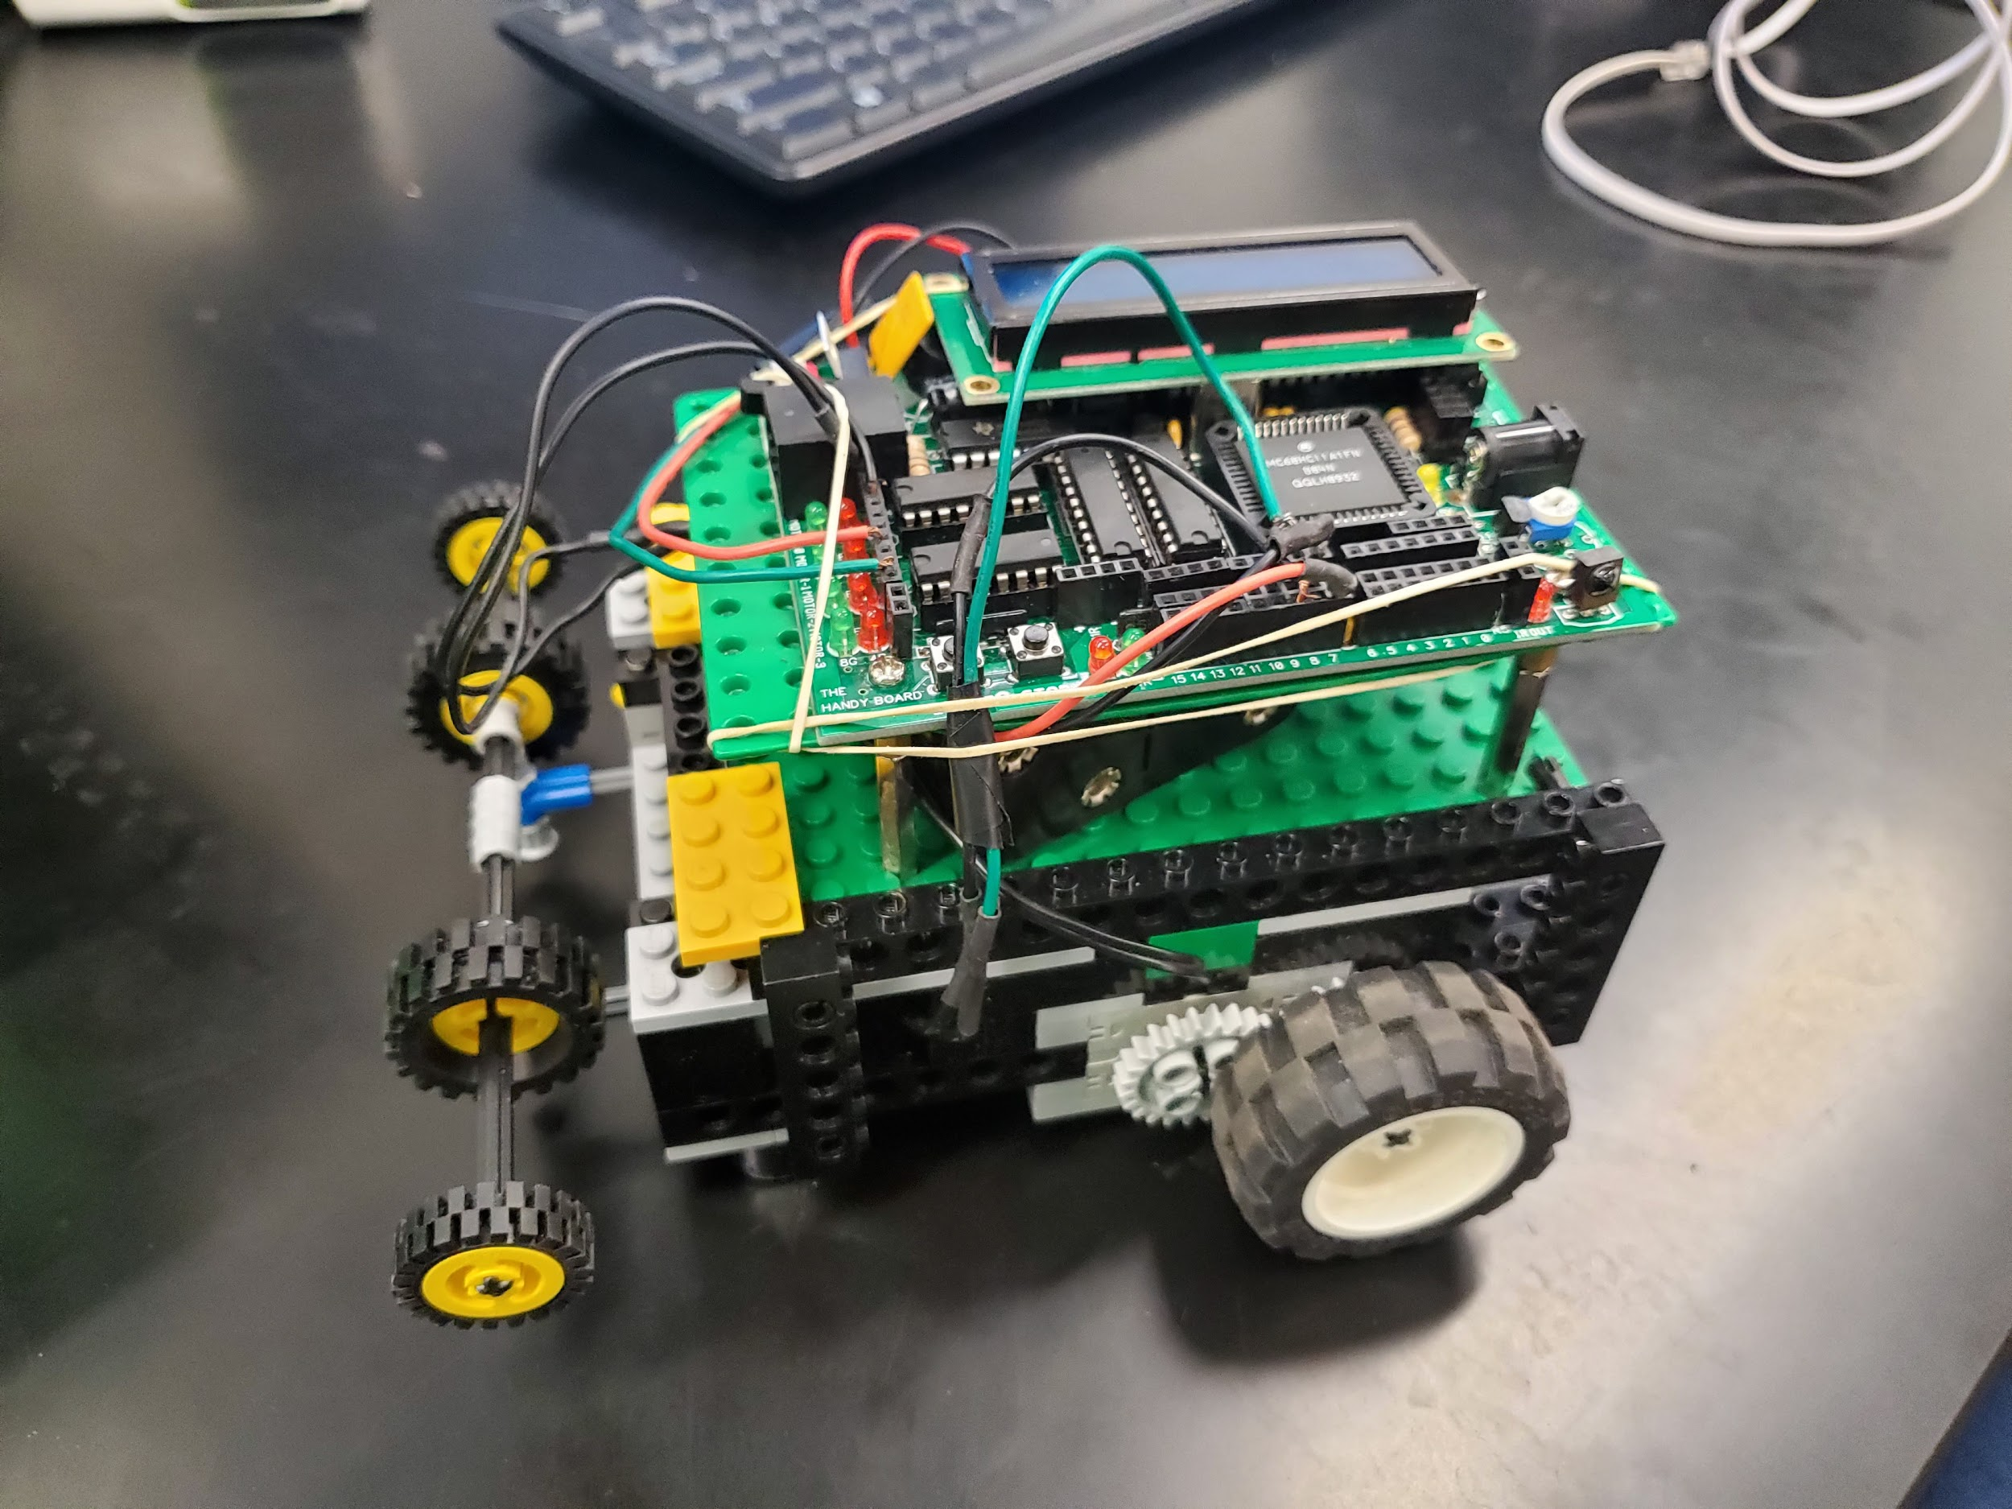
General Design
The general design was from Robotic Explorations by Fred G. Martin
Has two wheels
Both are driven by motors via gears
Uses two touch sensors activated by a bumper
Controlled by a Handy Board with an 8 bit Motorola microprocessor

Slide 5
Code
The HandyBoard uses Interactive C
The code allows the robot navigate the maze
Code the robot is using consists of several classes
Classes for movement, timing, randomization, and main are flashed on the robot
Bumper and sensors used for bump detection
If the robot is stuck it will randomize its turns

Slide 6
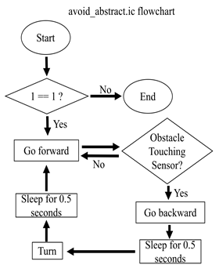
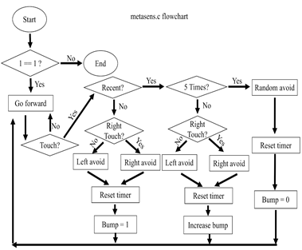

Slide 7
Alterations on the generic code-
There were alterations made to the generic code of the robot, to improve its chance to complete the maze.
We kept a left curve in the motion for the robot to track the wall during its navigation.
When the robot collided with a wall, a little back motion was placed in order for it to make a proper turn.
The sleep time was increased for the robot to make right angle turns.
When the random sequence was activated, the robot turned 270 degrees in order to move out of the dead-end.

Slide 8
Construction
The robot is constructed using Lego technic bricks, gears, and wheels.
The robot used two servo-motors and two touch sensors.
The servo motors were used for the movement of the robot and using the codes the robot could move-
Forward
Backward
Left
Right
The touch sensors were placed in the front of the robot to enable to robot to react to an obstacle in front.
The connecting cables were connected to alternating ports in order to maximize the output from the handy-board.

Slide 9
Alterations made on the generic design
Addition of extra tires in the bummer, was used as shock absorbers when the robot was moving fast.
The gear ratio was changed from 1:8 to 1:1 in order to make the robot move faster.
The battery-pack had supporters in order to prevent the battery-pack from moving.
The robot tire size was also changed in order for it to move without any drag and make the robot lighter.
The connecting cables were tied to the chassis to avoid lose connections.

Slide 10
Testing
The robot had been tested several times in the 3 labs that took place, each time only a fraction of its program was put into the coding to test its initial state.
The final product ( final hardware design & software configurations) was tested in lab 3. After one faulty run, the power to the left motor was changed to 65.
Two more trial runs were held and the robot was successful in both.
The hardware was well built and did not fall off as opposed to previous lab trials.
During the competition, the robot had taken faulty turns from its random function purely due to luck. Thus was only able to earn itself 4 and 6 points on the maze respectively.

Slide 11
Final Evaluation
Possible Problems:
The irregularity of the random function
Loose connections on the handy board
Assuming the perfect power for each motor for travelling in a straight line.
Solutions:
Preparing a more detailed program function to combine with metasens.ic, to prevent depending on luck to get out of tricky situations

Slide 12
Final Evaluation
Solutions:
Use tape to get secure wire connections between motors/ sensors and the handy board.
Pre Provided with motors that produce the same power or testing the motors using tachometers several times and then taking averages of the tests thus reducing the room of error from assumptions.
Precautions for future work:
Take into account the existing problems and apply the required solutions starting from scratch, as later applications may seem to be more complicated and unruly.

